Slide 1
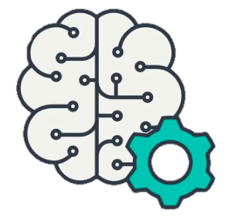
Social Distance Measurement and Face Mask Detection using Deep Learning Models
Md Mahabub Alam
Department of Electrical and Computer Engineering
North South University
Dhaka, Bangladesh
Md Naimul Islam Suvon
Department of Electrical and Computer Engineering
North South University
Dhaka, Bangladesh
Riasat Khan
Department of Electrical and Computer Engineering
North South University
Dhaka, Bangladesh

Slide 2
Introduction & Motivation
COVID-19 became a significant problem in today's world. Everyone needs to maintain social distance and wear masks.
Not everyone are willing to follow this protocol so we need monitoring.
Our System has two different sections. In the first section, we will build a social distance measurement system. We have many CC cameras in our universities. We can add the system to the cameras to monitor the students to maintain social distance when the universities gets open.
Our second system will be a face mask detection system. As very soon all the universities will be open so this system can be used at the entrance of the university gate so that no student can go inside university without wearing facemask.
1
Notes:
Covid-19 became a significant problem in today's world. It is not only affecting the people physically but also effecting a country financially. Even after everything goes normal, it will be very tough for everyone to cover the damages. We can't live like this forever. So soon if the universities are open, our System will immensely help full for university, especially in our university. Not only universities it can be used in big shopping malls also.

Slide 3
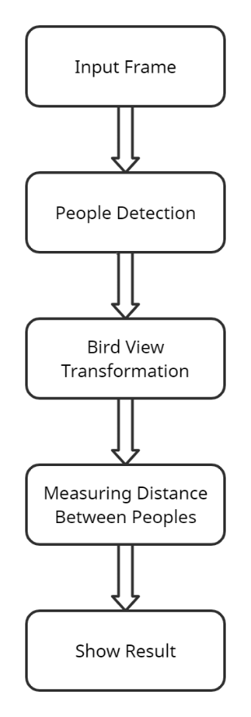
Social Distancing Detection System Diagram

Slide 4
Model Selection
All the models available on the TensorFlow object detection model have been trained on the COCO dataset .
There are many pretrained model on this coco dataset. The architecture of each of this model is unique which allows for faster/slower detections and more/less accuracy etc.
SSD-MobileNet model have an architecture that allows for faster detection but with less accuracy, while some models (such as the Faster-RCNN model) give slower detection but with more accuracy.
Finally, we have chosen the ssd_mobilenet_v1_coco model, which has a MAP (detector performance on a validation set) of 21, which is quite strong, and an execution speed of 30 ms.

Slide 5
Bird View Transformation
The first step involves selecting 4 points on the original image that are going to be the corner points of the plan which is going to be transformed. This points have to form a rectangle with at least 2 opposite sides being parallel. If this is not done, the proportions will not be the same when the transformation happens.
Get the bounding box for each person detected in the original frame.
Compute the lowest point of this box. It is the point located between both feet.
Use the transformation matrix to each of theses points to get the real “GPS” coordinates of each person.
Notes:
Performing a bird eye view transformation gives us a top view of a scene.OpenCV has great built-in functions to apply this method to an image in order to transform an image taken from a perspective point of view to a top view of this image.
Step 1: The first step involves selecting 4 points on the original image that are going to be the corner points of the plan which is going to be transformed. This points have to form a rectangle with at least 2 opposite sides being parallel. If this is not done, the proportions will not be the same when the transformation happens
Step 2: It is far more accurate to use these than use the original ground points, because in a perspective view, the distance are not the same when people are in different plans, not at the same distance from the camera. Compared to using the points in the original frame, this could improve the social distancing measurement a lot.

Slide 6
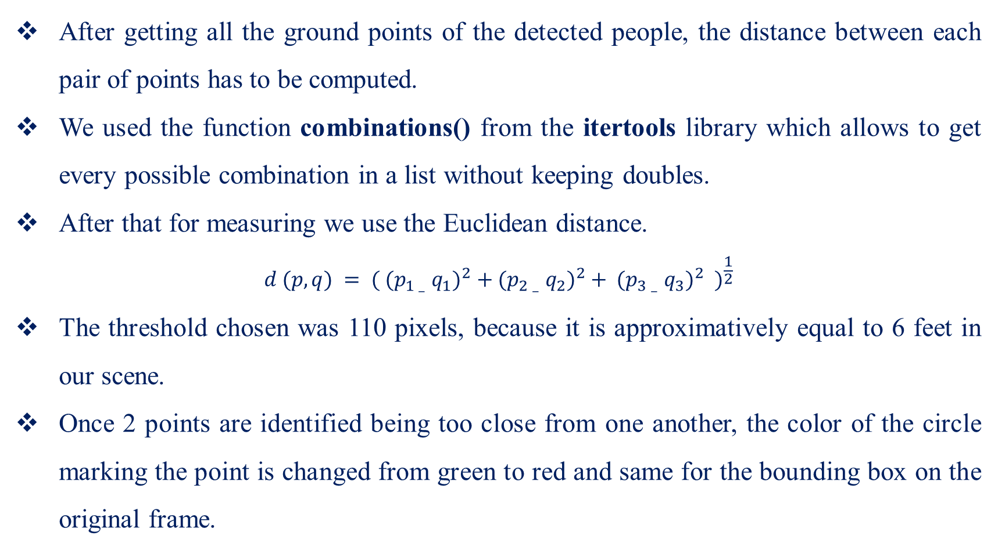
Measuring Social Distancing
After getting all the ground points of the detected people, the distance between each pair of points has to be computed.
We used the function combinations() from the itertools library which allows to get every possible combination in a list without keeping doubles.
After that for measuring we use the Euclidean distance.
$$d (p, q) = {( {(p_{1} – q_{1})}^{2} + {(p_{2} – q_{2})}^{2} + {(p_{3} – q_{3})}^{2} )}^{\frac{1}{2}}$$
The threshold chosen was 110 pixels, because it is approximatively equal to 6 feet in our scene.
Once 2 points are identified being too close from one another, the color of the circle marking the point is changed from green to red and same for the bounding box on the original frame.

Slide 7
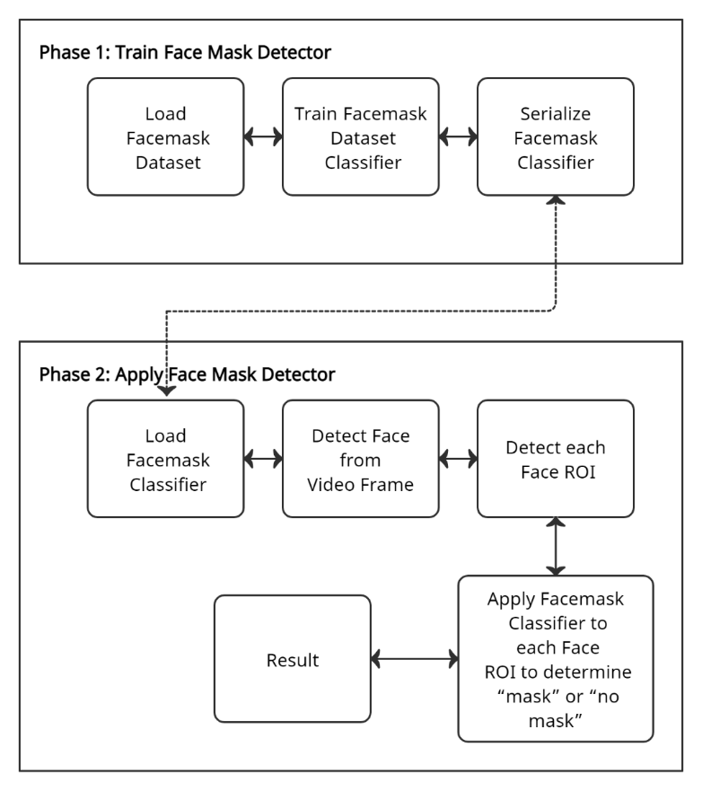
Facemask Detection System Diagram

Slide 8
Facemask Detection Dataset Preparation & Model Selection
Facemask dataset: Total images 1,376
690 images with mask
686 images without mask
Two classes almost 1:1 ratio
Mobile Net V2 architecture
Highly efficient architecture specially for embedded devices with minimum computational capacity.

Slide 9
Facemask Detection Training
Firstly, loaded the MobileNetV2 with pre-trained ImageNet weights
By Leaving off head of network the MobileNetV2
Next, constructed a new fully-connected head
After that, append it to the base in place of the old head
Lastly, freeze the base layer of the network where the weights of this base layer will not be updated during the process of backpropagation.

Slide 10
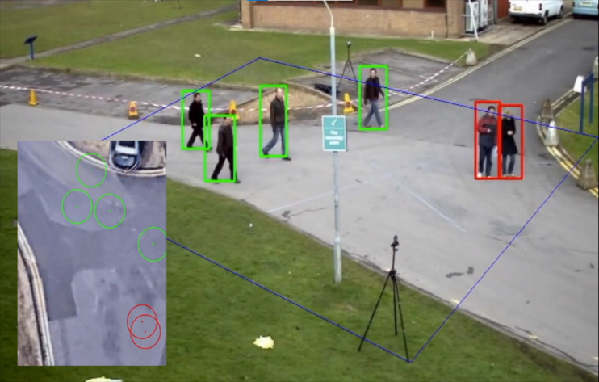
Performance of Social Distancing Detection
Notes:
In this Image we have shown an image by running our System on it. We can see the bird view on a small screen (lower left corner of the image), which is the four corner points that we take from the original image and transform it into a bird view with a ground point for each person. We can see when the person is too close to each other (below the predefined threshold of 120 pixels), the circle of the small bird view screen goes red, and the box plotted a portion of that particular person's get red.

Slide 11
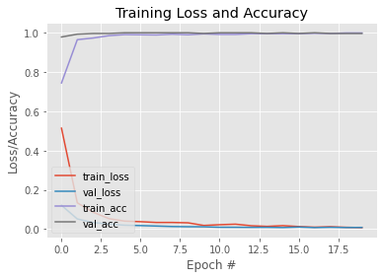
Performance of Facemask Detection
Notes:
During the training we have used 34 epoch and validate our model with 276 (20%) sample images. In out loss vs accuracy graph Our facemask detector training accuracy and loss curves illustrates high accuracy and little sign of overfitting on the data with the validation loss lower than the training loss. We have got ~99% accuracy in our test set.

Slide 12
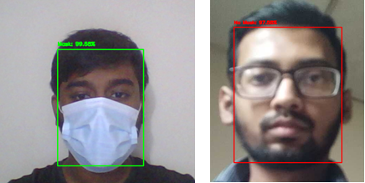
Performance of Facemask Detection
The images are outside the training and testing dataset in real-time video frames.
Our model can also detect a face without mask in real-time with high accuracy.
Notes:
we have tried it in real environment by using a mobile IP camera which is connected to our program to see if it is working well and surprisingly it is working pretty well with Realtime video. It indicates that out trained model can detect sample from outside our training and testing dataset.

Slide 13
Conclusion & Future Work
Nowadays, social distancing along with other basic sanitary measures are very important to keep the spread of the COVID-19 as slow as possible.
New innovation in Bangladesh
Product level implementation by implementing it into a microprocessor.
Can have a high market demand after the opening of Educational institution.

Slide 14
THANK YOU

